Slide 1
PROJECT TITLE:- Temperature Controlled Fan Using ESP8266

Slide 2
INTRODUCTION :-
The ESP8266 (NodeMCU), an LM35 temperature sensor and a relay module are used in this project to create a Temperature Controlled Fan. The NodeMCU receives analog signals from the LM35 sensor, which continuously measures the outside temperature. The relay is triggered to turn on a DC fan when the temperature rises above a predetermined threshold, such as 30°C. The fan automatically shuts off if the temperature drops below the threshold. This system is perfect for applications like energy-efficient ventilation or smart cooling because it helps maintain a controlled environment.

Slide 3
Objectives
1. Aim is to automatically turn on or off an DC fan depending on the room temperature.
2. Utilizing an NodeMCU (ESP8266) to process the temperature data and control the fan through a relay module.
3. Implementing a relay so that the switch safely turn on & off the DC fan, preventing direct exposure to high voltage​.
4. Offers a self made method to maintain comfortable room temperature without manual fan operation.

Slide 4
METHODOLOGY :-
1. Designing of the System:
The design of the system is all about reading temperature using the LM35 sensor and using the data to control the speed of a AC fan
The fan speed is adjusted using PWM signals from the Arduino based on the temperature.
2. Algorithm:
Reading analog voltage from LM35
Converting voltage to temperature using the formula:
Temperature (°C) = (Analog Voltage in mV) / 10
Checking the temperature range and set fan speed accordingly:
Below threshold (e.g., <25°C): Fan OFF
Medium range (25°C–35°C): Medium speed
Higher range (>35°C): High speed or full speed
Generating PWM output from Arduino to control the transistor and, in turn, the fan speed.
3. Coding (Arduino Programming):
Embedded C/C++ using Arduino IDE.
Using analogRead() for sensor input and analogWrite() to generate PWM signals.
Including conditional logic to control fan speed based on temperature ranges.

Slide 5
Hardware Tools & Components:-
NodeMCU (ESP8266)
LM35 temperature sensor
5V single channel Relay Module
DC Fan (12V/5V)
DC Adapter
Jumper Wires
Software Tools:-
1. Arduino IDE
2. Embedded C/C++ Programming language used in the Arduino sketch.

Slide 6
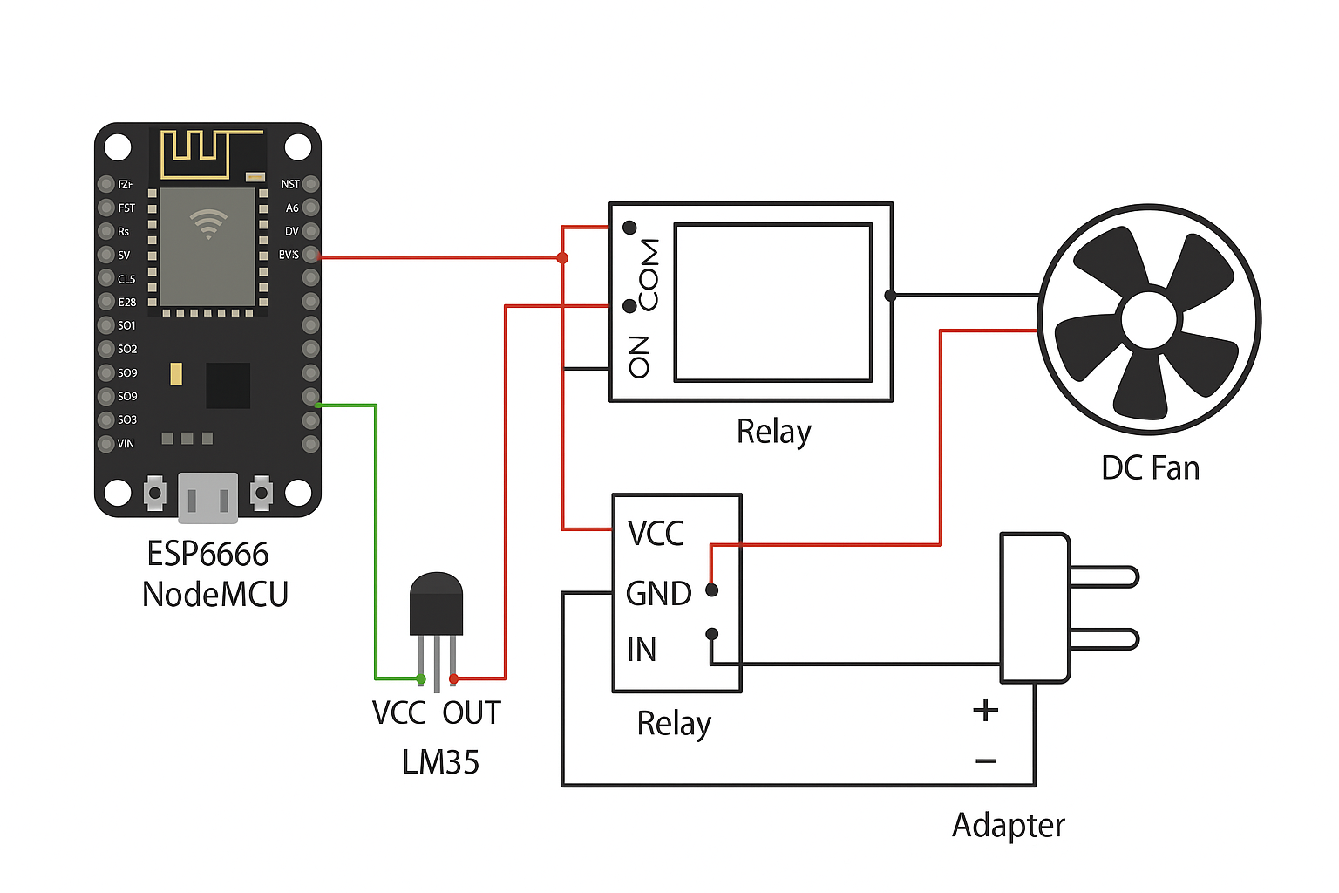
Hardware Integration & Circuit Design
1. LM35 to NodeMCU:
VCC → 3V3
GND → GND
OUT → A0
2. Relay to NodeMCU:
VCC → 3V3
GND → GND
IN → D1 (GPIO5)
3. Fan via Relay and Adapter:
Adapter + → Relay COM
Relay NO → Fan +ve
Adapter – → Fan –ve

Slide 7
Results & Discussion
1. The system accurately sensed temperature using the LM35 sensor and displayed readings via the serial monitor.
2. The fan turned ON when temperature exceeded 30°C and turned OFF when it dropped below, as expected.
3. Relay switching was stable, with no false triggering or flickering during operation.
4. Electrical isolation between the ESP8266 and fan power ensured safe and reliable performance.
5. The setup is suitable for smart cooling applications and can be extended to IoT-based monitoring.

